Slide 1

TrustlessID — Decentralized Digital Identity Platform
Tagline: "Own Your Identity. Trust No One." — A working MVP that replaces brittle centralised identity systems with privacy-first, AI-verified, blockchain-anchored credentials.

Slide 2
Executive Summary
TrustlessID addresses a global identity emergency: 4.7B people lack verifiable digital identity, while identity fraud costs companies and economies $56B annually and 80% of breaches stem from exposed personal data. Our platform is a production-ready, privacy-first web application combining AI document verification, a fraud-detection pipeline, SHA-256 credential anchoring, and W3C DID-compliant verifiable credentials. The system eliminates central personal-data storage: only cryptographic hashes are recorded. Users prove assertions with selective disclosure; third parties verify without seeing underlying data. The MVP demonstrates the full 5-step identity creation flow, public verification, and an enterprise-ready API surface. TrustlessID is built with modern tooling (Next.js 14, TypeScript, Tailwind, shadcn/ui) and a modular AI/crypto backend. We are seeking validation, pilot partners, and scaling capital to move from demo hashing to on-chain anchoring, enterprise integrations and biometric options. In short: we remove the honeypot, raise the bar on fraud detection, and put identity control back where it belongs — with the individual.

Slide 3

Problem Statement — The Identity Crisis
Digital identity is failing at global scale. 4.7 billion people remain effectively excluded from basic services because they lack verifiable digital IDs. Fraudsters extract $56 billion yearly via synthetic identities and deepfake forgeries. Meanwhile, 80% of major breaches involve exposed personal information, proving centralised identity stores are honeypots. Traditional KYC replicates the vulnerability: organisations collect and store sensitive documents, providing attackers concentrated targets. AI-driven deepfakes and synthetic documents now defeat many legacy verification systems. The result: exclusion, financial loss, and systemic risk to institutions and citizens alike.

Slide 4



Solution Overview — What TrustlessID Delivers
TrustlessID is a privacy-first, AI-powered, blockchain-backed platform that issues tamper-proof identity credentials without ever storing personal data centrally. Key capabilities:
AI Document Verification
Blockchain-Backed Credentials
Zero Data Exposure
Selective disclosure enables fact verification (e.g., age) without revealing underlying PII. No PII stored on TrustlessID servers.
Multilayer authenticity checks, OCR, tamper detection and deepfake screening producing confidence scores and anomaly counts.
SHA-256-based credential hashing recorded for immutability; W3C DID & Verifiable Credentials compatible for global interoperability.

Slide 5


Technical Innovation — AI Verification & Fraud Detection
The AI verification stack runs a layered analysis pipeline: image integrity checks, document template matching, OCR extraction, metadata consistency, and deepfake synthesis detection. Each document yields an authenticity percentage, a confidence score, and an anomaly count. Parallel to verification, a specialised fraud engine computes a composite risk score (0–100) combining deepfake likelihood, data inconsistency, behavioral telemetry and provenance metadata. The system outputs human-actionable recommendations (approve / challenge / manual review) and logs structured evidence designed for auditability.
Real-time processing supports live demo flows and configurable thresholds for enterprise SLAs.

Slide 6
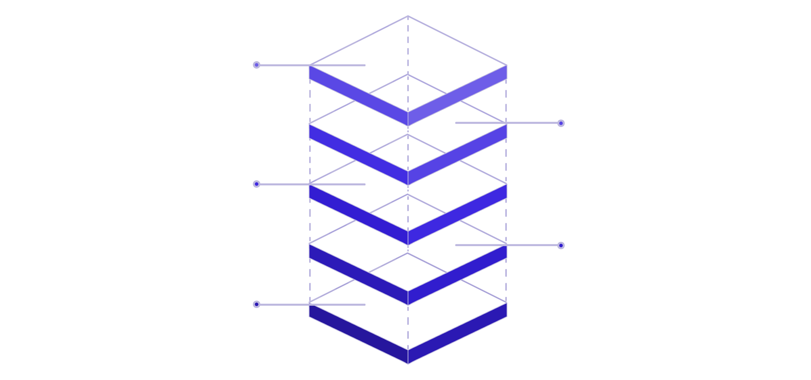
Anchoring & Registry
Optional on-chain anchor and DID
Crypto Module
Compute SHA-256 hashes only
Verification Engine
AI verification + fraud detection
API Gateway
Routes requests, forwards payloads
Frontend
Stateless Next.js UI for uploads
Architecture summary: a stateless Next.js frontend communicates with an API gateway that forwards uploads to the AI verification cluster. After analysis, the Crypto Module computes a SHA-256 credential hash and issues a W3C DID-compatible Verifiable Credential. Only the cryptographic anchor and minimal audit metadata persist. A public verification endpoint validates credential IDs against anchors and verifies signatures — with zero access to raw personal data.

Slide 7

5-Step Identity Wizard (Live MVP)
1. Basic Info
2. Document Upload
3. AI Analysis
Collect name, DOB, nationality — minimal required fields.
Authenticity % and OCR extraction with animated processing.
Passport, driver's licence or national ID — guided capture UI.
4. Fraud Scoring
5. Credential Issuance
Composite risk score, deepfake flags, reviewer notes.
SHA-256 hash anchored → Credential ID, expiry and public verification.

Slide 8
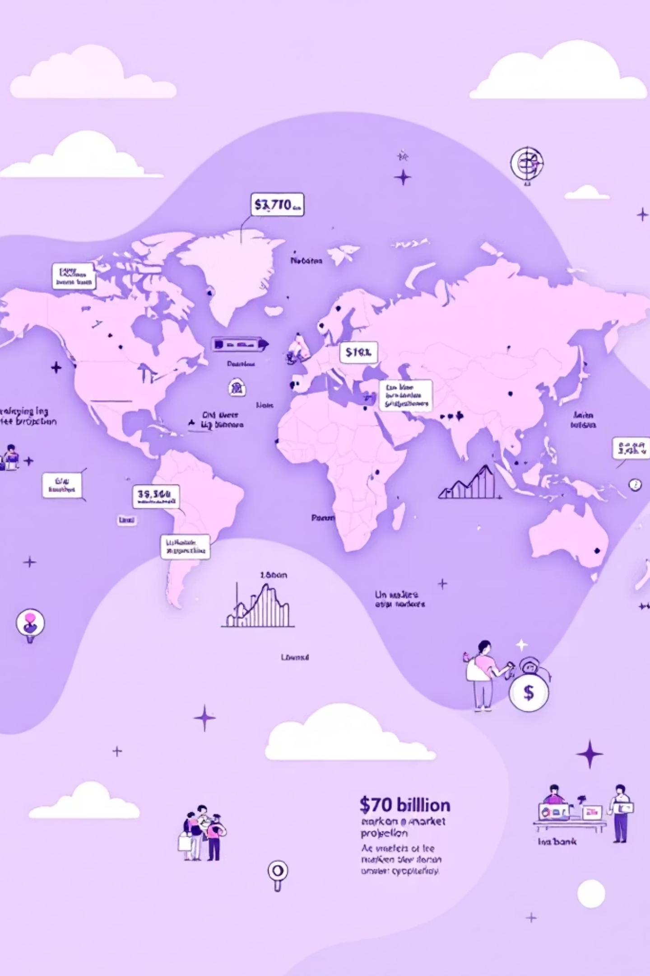
Market Opportunity & Impact
The digital identity market projects $70+ billion by 2027. TrustlessID targets a huge underserved base: 4.7B people without verifiable IDs — refugees, unbanked individuals, gig workers and millions in emerging markets. Regulatory shifts (eIDAS 2.0) and distrust in central databases create an adoption tailwind. Social impact is profound: enabling access to banking, healthcare and employment while dramatically reducing $56B in fraud exposure by removing centralised attack surfaces. Enterprise buyers benefit from KYC that avoids storing documents, reducing compliance and breach risk, and governments gain a portable, standards-compliant identity layer.

Slide 9



Competitive Differentiation
Privacy by Default
AI-First Fraud Detection
No PII stored; cryptographic anchors only.
Deepfake detection and composite risk scoring out of the box.
Standards & Interoperability
Working Prototype
W3C DID + Verifiable Credentials for portability.
Full end-to-end demo including public verification — not just a paper design.
Compared with traditional KYC and centralised ID providers, TrustlessID uniquely combines no central data storage, AI fraud detection, SHA-256 anchoring and open standards — dramatically lowering breach risk and increasing trustworthiness.

Slide 10


Roadmap, Ask & Conclusion
Phase 1 (Now)
12 months
Working MVP, demo flows, public verification.
Mobile app, government pilots, global scaling partnerships.
1
2
3
6 months
On-chain anchoring, biometric auth, hardened enterprise API.
Conclusion
Ask: pilot partners, regulatory sandbox access, and seed funding to accelerate on-chain integration and enterprise sales.
TrustlessID eliminates the single biggest vulnerability in digital identity: centralised data. It replaces trust in organisations with cryptographic certainty and AI-verified evidence. With a working MVP and standards-first design, we are positioned to reduce fraud, unlock access for 4.7B people, and capture a share of a $70B market. Judges: fund this now to turn a working prototype into global infrastructure for identity that respects privacy and resists fraud.

